Slide 1

New Trends in Energy Smart grids
Constantinos Taliotis
taliotis@kth.se
Introductory lecture – Energy commodities and technologies
This work by OpTIMUS.community is licensed under the Creative Commons Attribution 4.0 International License. To view a copy of this license, visit http://creativecommons.org/licenses/by/4.0/.
Notes:
Good afternoon and welcome to the lecture on “…”.
Introduce yourself and your research, field of expertise

Slide 2
Motivation for energy technology research and development
Notes:
To start with, it’s important to understand why efforts are put into improving the structure of the current energy system. For instance, even in Sweden where the share of renewables is very high in comparison with the rest of the world (or even EU), there are efforts to transform the energy system into completely carbon free in the next few decades. This is not trivial, considering the fact that the transport sector is heavily reliant on oil products.

Slide 3
Why innovate?
Energy Efficiency – Cost Efficiency
The cheapest kWh is a kWh not generated
Making the best out of the available resources
Energy Security
Resilient and robust energy system
Taking advantage of domestic energy sources leads to reduced reliance on fuel imports
Climate Change
Transition to low-carbon economy
Health and environment
Reduced emission of air and water pollutants that adversely affect health
Notes:
>Moving on, one important aspect to improve on is energy efficiency, which directly corresponds to a more cost-efficient system. In terms of electricity generation, the cheapest kWh is a kWh not generated – this can be achieved for instance with better thermal insulation, thus reducing the need for heating or cooling.
>Furthermore, technology improvements help in strengthening the resilience and robustness of the energy system, as for example it can withstand outages more effectively. In addition, by maximizing the use of domestic energy sources, import dependency is reduced and disruptions in fuel supply and price fluctuations are avoided. For instance, EV owners charging their vehicles with electricity from domestic solar and wind technologies, remain unaffected in the case of sudden surges in oil price.
>In addition, future deployment of technologies that help reduce CO2 emissions is significant. Finally, emissions of air and water pollutants that adversely affect health public health and the environment can be reduced.
All of these aspects are connected to each of the technology options we will discuss today

Slide 4
Smart grids
Notes:
So, let’s start with the concept of smart grids.

Slide 5
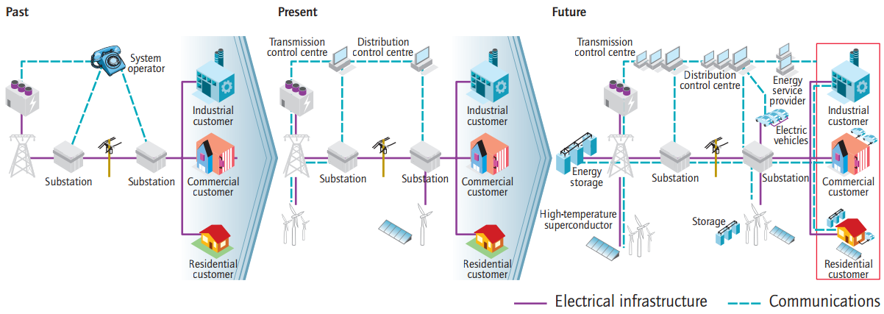
Smart Grids
Built on a significant increase in the level of communication, automation and control based on a two-way flow of information and electricity, between supplier and consumer.
Source: IEA, 2011. Smart Grids – Technology Roadmap
Notes:
The smart grids concept is built on a significant increase in the level of communication, automation and control based on a two-way flow of information and electricity, between supplier and consumer. (go over the figures)
>50% of household demand not instantly required
According to ACER’s estimates, currently only 10% of demand response resources is being utilised within the EU.

Slide 6
Smart Grids – What can they offer?
Enable informed participation by customers
Accommodate all generation and storage options
Enable new products, services and markets
Optimise asset utilisation and operating efficiency
Provide resiliency to disturbances, attacks and natural disasters
Source: IEA, 2011. Smart Grids – Technology Roadmap
Notes:
Enables informed participation by customers: Consumers help balance supply and demand, and ensure reliability by modifying the way they use and purchase electricity. These modifications come as a result of consumers having choices that motivate different purchasing patterns and behaviour. These choices involve new technologies, new information about their electricity use, and new forms of electricity pricing and incentives.
Accommodates all generation and storage options: A smart grid accommodates not only large, centralised power plants, but also the growing array of customer-sited distributed energy resources. Integration of these resources – including renewables, small-scale combined heat and power, and energy storage – will increase rapidly all along the value chain, from suppliers to marketers to customers.
Enables new products, services and markets: Correctly designed and operated markets efficiently create an opportunity for consumers to choose among competing services.
Optimises asset utilisation and operating efficiency: A smart grid applies the latest technologies to optimise the use of its assets. For example, maintenance efficiency can be optimised with condition-based maintenance, which signals the need for equipment maintenance at precisely the right time. System-control devices can be adjusted to reduce losses and eliminate congestion. Operating efficiency increases when selecting the least-cost energy-delivery system available through these types of system-control devices.
Provides resiliency to disturbances, attacks and natural disasters: Resiliency refers to the ability of a system to react to unexpected events by isolating problematic elements while the rest of the system is restored to normal operation. These self-healing actions result in reduced interruption of service to consumers and help service providers better manage the delivery infrastructure.
Smart grids are self healing, and are able to contain outages, thus minimising their duration and cost
Minimising impacts of outages through prioritising loads (hospitals /industry)
New sources of flexibility (demand-side)
Provides the power quality for the range of needs: Not all commercial enterprises, and certainly not all residential customers, need the same quality of power. A smart grid supplies varying grades (and prices) of power. The cost of premium power-quality features can be included in the electrical service contract. Advanced control methods monitor essential components, enabling rapid diagnosis and solutions to events that impact power quality, such as lightning, switching surges, line faults and harmonic sources.

Slide 7
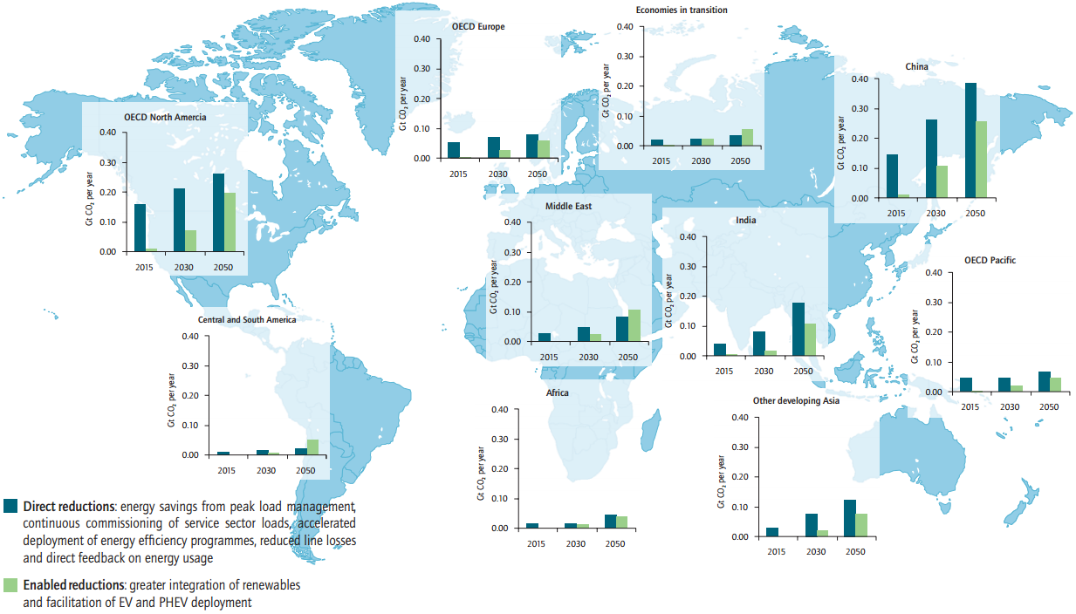
Smart Grids – What can they offer
Source: IEA, 2011. Smart Grids – Technology Roadmap
Notes:
This figure shows reductions in CO2 emissions in different regions of the world, achieved through the deployment of smart grids. This scenario (the ETP BLUE scenario of the IEA) aims to ensure that global energy-related CO2 emissions are reduced to half their current (2010) levels by 2050. This scenario examines ways in which the introduction of existing and new low-carbon technologies might achieve this at least cost. The blue bar refers to direct reductions (through energy efficiency, peak demand management etc), while the green bar shows additional indirect emissions through greater integration of RE achieved through EV and PHEV deployment.
KEY POINT: Smart grid deployment enables significant CO2 emissions reductions.
Taking these direct and indirect emissions reductions into account, the ETP BLUE Map Scenario estimates that smart grids offer the potential to achieve net annual emissions reductions of up to 2.1 Gt of CO2 by 2050
>>Current annual global CO2 emissions at about 10 Gt

Slide 8
Suggested further reading
IEA Technology Roadmap: Smart Grids
http://www.oecd-ilibrary.org/energy/technology-roadmap-smart-grids_9789264115071-en

Slide 9
Changelog and attribution
Date | Author | Reviewer | Reviser
2017-10-10 | Constantinos Taliotis | Agnese Beltramo | Constantinos Taliotis
To correctly reference this work, please use the following:
Taliotis, C., 2017. New Trends in Energy – Smart grids, OpTIMUS.community. Available at: http://www.osemosys.org/understanding-the-energy-system.html. [Access date]

